Slide 1
Class and Interface Design
Prof. Dr. Dirk Riehle
Friedrich-Alexander University Erlangen-Nürnberg
ADAP C02
Licensed under CC BY 4.0 International
Notes:
It is Friedrich-Alexander University Erlangen-Nürnberg – FAU, in short.
Corporate identity wants us to say “Friedrich-Alexander University”.

Slide 2
Agenda
Classes vs. interfaces
Abstract state model
Program to an interface
Design by primitives
Simple class design
Inheritance interface
Class design evolution
Special purpose classes

Slide 3
1. Classes vs. Interfaces

Slide 4
Class and Interface Design
Design of
  Use-client interfaces
  Class implementations
  Inheritance interfaces

Slide 5
Objects and Classes
The modeling perspective
  An object is the representation of a phenomenon from a domain
  A class is a description of the commonalities of similar objects
The technology perspective
  An object is an encapsulation of some program state
  A class is the implementation of how to change that state
Here, we will focus on the technology perspective

Slide 6
Classes and Interfaces
Interface
  The abstract description of some object behavior
    Includes an abstract state model and state transitions
  To be implemented by abstract and/or concrete classes
Abstract class
  A partial implementation of an interface’s behavior
    Sets up algorithmic scaffolding for concrete subclasses
  Implements an interface, to be extended by subclasses
Implementation class
  A concrete (complete) implementation of an interface’s behavior
    Includes implementation state (Java fields)
  Directly implements an interface or extends an abstract class

Slide 7
Java Classes and Interfaces
A Java interface is an interface
A Java class has an interface
  This interface is conceptually separate from the implementation
  Cf. C++ where classes are split in header and implementation files
A Java class can be an abstract class
  By declaration using “abstract”
  By not providing a public constructor
  By having abstract methods

Slide 8
2. Abstract State Model

Slide 9
Abstract State Model
An interface expresses an abstract state model
You cannot (should not) call delete on an open file
Simple SeqFile state model
open
read
write
open
closed
deleted
close

Slide 10
Interface and Implementation of SeqFile
public class SeqFile {
public boolean isOpen() {
...
}
public boolean isClosed() {
...
}
public byte[] read() {
assertIsOpen();
...
}
public void delete() {
assertIsClosed();
...
}
...

Slide 11
Abstract State vs. Implementation State
Abstract State
Implementation State
public interface SeqFile {
public boolean isEmpty();
public boolean isOpen();
...
}
public class ByteFile
implements SeqFile {
protected byte[] data;
protected int length;
public boolean isEmpty() {
return length == 0;
}
...
}

Slide 12
3. Program to an Interface

Slide 13
Program to an Interface Principle 1 / 2
Program to an interface,
not an implementation

Slide 14
Program to an Interface Principle 2 / 2
Program to an abstract state model
  Do not rely on any implementation details
Do not rely on what is not in the interface
  Do not expect implementation side-effects
  Do not rely on specific performance unless guaranteed
When can you not use the interface?

Slide 15
Class Implementation
A concrete implementation class
  has an interface that is a superset of any interfaces it implements
  is a complete implementation of that class
  implements an abstract state model

Slide 16
4. Design by Primitives

Slide 17
Design by Primitives
Design by primitives
  The implementation state of a concrete class is covered by primitive methods
  All other methods should utilize these primitive methods
Corollaries
  Do not change any fields outside the primitive methods
  Prepares for implementation evolution

Slide 18
Implementation with Design by Primitives
public void insert(int i, String c) {
assertIsValidIndex(i, getNoComponents() + 1);
assertIsNonNullArgument(c);
int oldNoComponents = getNoComponents();
doInsert(i, c);
assert (oldNoComponents + 1) == getNoComponents() : "pc failed";
}
protected void doInsert(int index, String component) {
int newSize = getNoComponents() + 1;
String[] newComponents = new String[newSize];
for (int i = 0, j = 0; j < newSize; j++) {
if (j != index) {
newComponents[j] = components[i++];
} else {
newComponents[j] = component;
}
}
components = newComponents;
}

Slide 19
Quiz: Implementing Primitives
Would you implement doSetComponent as shown?
If so, under which circumstances? If not, why not?
public void setComponent(int i, String c) {
assertIsValidIndex(i);
doSetComponent(i, c);
}
protected void doSetComponent(int i, String c) {
doInsert(i, c);
doRemove(i + 1);
}

Slide 20
5. Simple Class Design

Slide 21
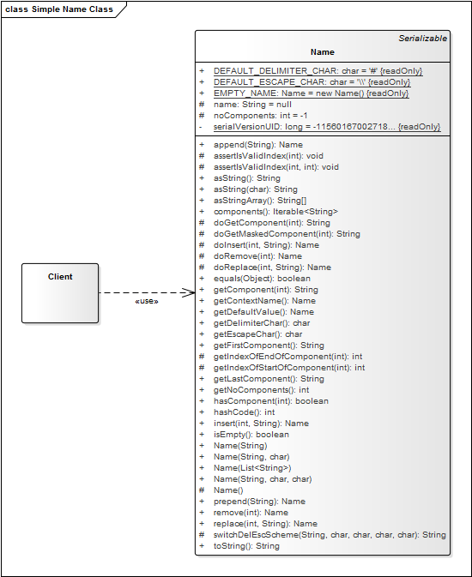
1. Simple Class

Slide 22
(Class) Interface of Name Class
public class Name {
public String asString() { /* ... */ }
public String asString(char delimiter) { /* ... */ }
public String[] asStringArray() { /* ... */ }
public String getComponent(int i) { /* ... */ }
public void hasComponent(String c) { /* ... */ }
public void setComponent(int i, String c) { /* ... */ }
public Iterator<String> iterator() { /* ... */ }
public void insert(int i, String c) { /* ... */ }
public void remove(int i) { /* ... */ }
...
}

Slide 23
Implementation of a Simple Name Class
public class Name {
protected String[] components;
protected int length;
public void remove(int index) {
assertIsValidIndex(index);
doRemove(index);
}
protected void doRemove(int i) {
System.arraycopy(components, i+1, components, i, length-i);
length -= 1;
}
protected void assertIsValidIndex(int index) {
if ((index < 0) && (index >= length)) {
throw new IndexOutOfBoundsException(“helpful message”);
}
}
...

Slide 24
How to Get to Methods
Use-client perspective
  Two perspectives: Feature implementation and tests
  Meyer recommends taking a shopping bag approach
Completeness / internal quality
  Completeness of protocols
  Experience with similar situations

Slide 25
How to Group Methods
Group methods by collaboration purpose
  Also called “roles” objects play, sometimes “traits” or “protocols”
  A protocol typically adds a more stringent specification
Smalltalk method categories (old and bad)
  Group getters and group setters separately
Various (browsing) views by IDEs
  Can only be based on language-level properties

Slide 26
6. Inheritance Interface

Slide 27
Inheritance Interface
Inheritance Interface
  The description of an abstract state space underlying the state model
  The use-client interface specifies the state model including all constraints
  The inheritance interface specifies the full state space and is unprotected [1]
Design by primitives
  The abstract state space should be represented by a set of primitive methods
  Typically, these primitive methods are hook methods
  They may have default implementations
Narrow inheritance interface principle
  The interface should be minimal to allow fast and simple implementation
  This may imply inefficient implementations in the abstract superclass
[1] In a larger system design context, you may want to protect superclasses against abuse, but in the one-system context here this is not of concern

Slide 28
AbstractName Inheritance Interface
public abstract class AbstractName implements Name {
...
public abstract int getNoComponents();
protected abstract String doGetComponent(int i);
protected abstract void doSetComponent(int i, String component);
protected abstract void doInsert(int index, String component);
protected abstract void doRemove(int index);
}
public class StringName
extends AbstractName {
protected int noComponents;
protected String name;
...
}
public class StringArrayName
extends AbstractName {
protected int noComponents;
protected String[] components;
...
}

Slide 29
The Narrow Inheritance Interface Principle
public abstract class AbstractName implements Name {
...
protected void doSetComponent(int i, String c) {
doInsert(i, c);
doRemove(i + 1);
}
...
public class StringArrayName extends AbstractName {
protected int noComponents;
protected String[] components;
protected void doSetComponent(int i, String c) {
components[i] = c;
}
...

Slide 30
Bottom-up or Top-down
Thinking the class hierarchy bottom-up
  A subclass calls methods from the superclass
    These are either helper methods
    Or the superclass has a different (domain) type
Thinking the class hierarchy top-down
  A superclass delegates implementation to subclasses
    The superclass provides the algorithm while
    the subclasses provide the implementation of the primitive steps

Slide 31
The Open / Closed Principle
The Open / Closed Principle
  “A class should be open for extension, but closed for modification”
  A moniker for one of the many rather vague “principles” of good design
A (somewhat) useful interpretation
  A class should be open for extension (that does not violate its interface)
  A class should be closed to modification (that would violate the interface)
To be replaced by two clearer rules
  Liskov substitutability principle [LW93]
  The abstract superclass rule [H94]

Slide 32
Quiz: Interface Structure
The methods of your class or interface are spread around and you want it to be more readable. How should you order your methods?
  By method type (getter, setter, ...)
  By method visibility (public, ...)
  By method purpose
  By client needs
    By use-client needs
    By inheritance-client needs
  Some or all of the above
Where do the implementation fields of a class go?
  Above the methods (start of class)
  Below the methods (end of class)
  Close to the methods using them
  Does not matter

Slide 33
7. Class Design Evolution

Slide 34
Class and Interface Evolution
Simple class
Interface separation
Implementation classes
Abstract superclass

Slide 35
2. Interface/Class Separation

Slide 36
3. Implementation Classes

Slide 37
4. Abstract Superclass

Slide 38
8. Special Purpose Classes

Slide 39
General Types of Classes
Simple class
  A class that implements it all
Interface (class)
  An interface definition for some classes
Implementation class
  A class that implements an interface
Abstract superclass
  An abstract class intended to be extended
Default implementation class
  An implementation class supposed to be the default choice

Slide 40
Special-Purpose Types of Classes
Tagging interface
  An interface indicating a hidden functionality
Mix-in class (trait class)
  A class providing partial implementation functionality
Design purpose
  Follows design pattern, e.g. Adapter, Factory

Slide 41
Summary
Classes vs. interfaces
Abstract state model
Program to an interface
Design by primitives
Simple class design
Inheritance interface
Class design evolution
Special purpose classes

Slide 42
Thank you! Questions?
dirk.riehle@fau.de – https://oss.cs.fau.de
dirk@riehle.org – https://dirkriehle.com – @dirkriehle
DR

Slide 43
Legal Notices
License
  Licensed under the CC BY 4.0 International License
Copyright
  © 2012-2022 Dirk Riehle, some rights reserved

